Slide 1
CONTINUATION OF WATER REQUIREMENTS AND AVAILABILITY RECONCILIATION STRATEGY FOR THE MBOMBELA MUNICIPAL AREA (Crocodile Sabie River System Reconciliation Strategy) Strategy Steering Committee Meeting StraSC 5 Tuesday, 6 October 2020

Slide 2
CONTINUATION OF WATER REQUIREMENTS AND AVAILABILITY RECONCILIATION STRATEGY FOR THE MBOMBELA MUNICIPAL AREA (Crocodile Sabie River System Reconciliation Strategy) Strategy Steering Committee Meeting StraSC 5 Item 2: Attendance and Apologies

Slide 3
CONTINUATION OF WATER REQUIREMENTS AND AVAILABILITY RECONCILIATION STRATEGY FOR THE MBOMBELA MUNICIPAL AREA (Crocodile Sabie River System Reconciliation Strategy) Strategy Steering Committee Meeting StraSC 5 Item 3: Acceptance of Agenda

Slide 4
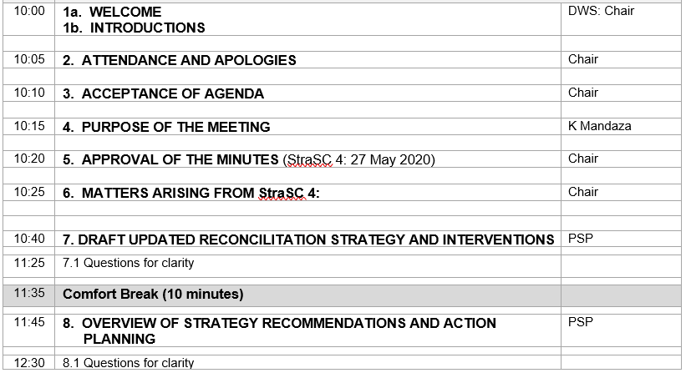
Agenda

Slide 5
CONTINUATION OF WATER REQUIREMENTS AND AVAILABILITY RECONCILIATION STRATEGY FOR THE MBOMBELA MUNICIPAL AREA (Crocodile Sabie River System Reconciliation Strategy) Strategy Steering Committee Meeting StraSC 5 Item 4: Purpose of the Meeting

Slide 6
Purpose
FINAL STRASC MEETING OF THIS PHASE OF STUDY
Continuation Phase being Initiated
PRESENT DRAFT STRATEGY
PRESENT AND GAIN APPROVAL FOR INTERVENTION ACTION PLAN AND RESPONSIBILITIES

Slide 7
CONTINUATION OF WATER REQUIREMENTS AND AVAILABILITY RECONCILIATION STRATEGY FOR THE MBOMBELA MUNICIPAL AREA (Crocodile Sabie River System Reconciliation Strategy) Strategy Steering Committee Meeting StraSC 5 Item 5&6: Approval of Minutes & Matters Arising

Slide 8
Matters Arising: Action list

Slide 9
Matters Arising: Action list

Slide 10
Matters Arising: Action list

Slide 11
CONTINUATION OF WATER REQUIREMENTS AND AVAILABILITY RECONCILIATION STRATEGY FOR THE MBOMBELA MUNICIPAL AREA (Crocodile Sabie River System Reconciliation Strategy) Strategy Steering Committee Meeting StraSC 5 Item 7: Presentation of Draft Reconciliation Strategy

Slide 12
OVERVIEW: TOC
Exec Summary
For document, expanded executive summary to be completed as separate deliverable
INTRODUCTION & CONTEXT
Eg. with Catchment Management Strategy
SUMMARY CHAPTERS ON INDIVIDUAL TASKS DETAILED IN STAND ALONE TECHNICAL REPORTS
Demographics & water requirements
WCWDM
Water Resources Availability

Slide 13
OVERVIEW: TOC
CURRENT WATER BALANCES
AVAILABLE INTERVENTION OPTIONS
WATER BALANCES INCLUDING OPTIONS
PROPOSED ACTION PLAN
FUTURE STRATEGY UPDATES

Slide 14
POSSIBLE INTERVENTION OPTIONS
REDUCE WATER USE
WCWDM
Reduce canal losses
Remove alien vegetation
Water use entitlement exchange from irrigation to urban
Eliminating unlawful uses
Compulsory licensing
Water Reuse

Slide 15
POSSIBLE INTERVENTION OPTIONS
INCREASE WATER SUPPLY
Interim Restriction Rule to Benefit Priority (Primary) Users
Efficient system operation
Groundwater Development
New Dam Construction & Existing Dam Raising
Water transfers

Slide 16
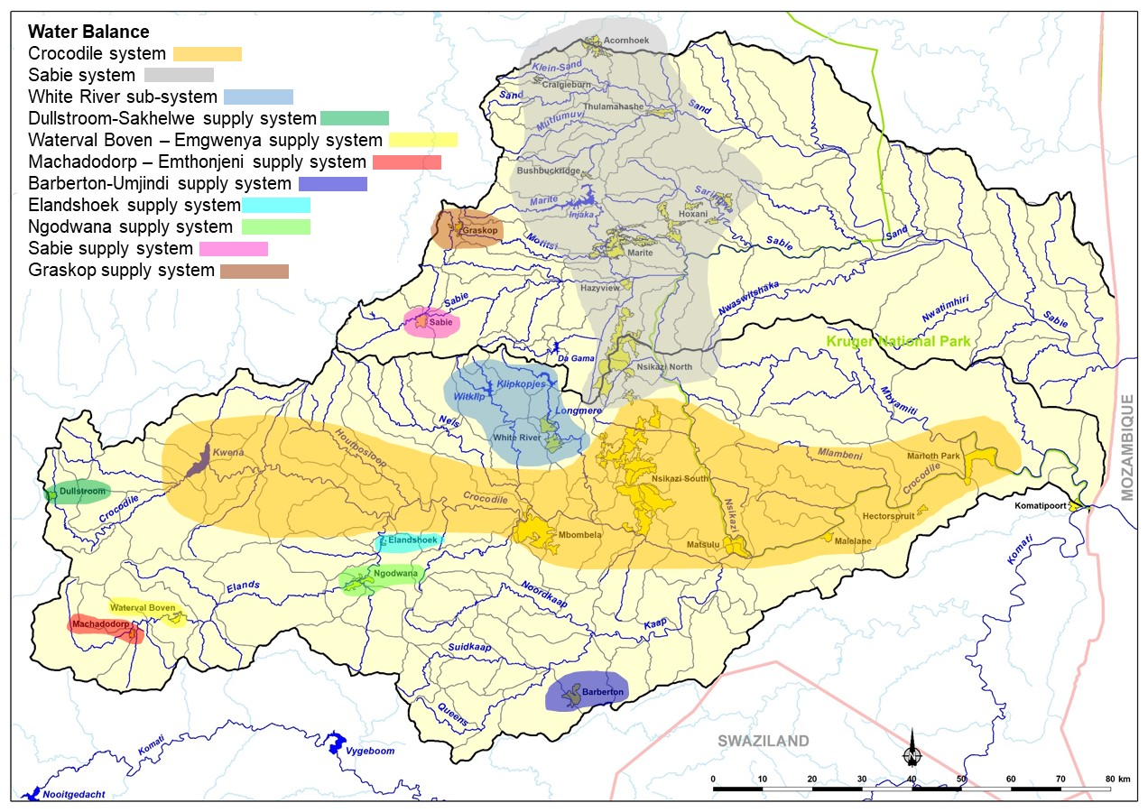
CURRENT WATER BALANCES

Slide 17
Recap water resources

Slide 18
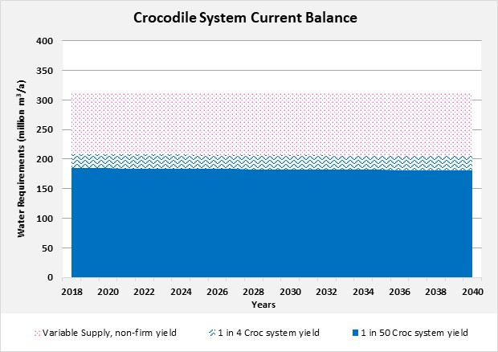
CROCODILE SYSTEM: yields

Slide 19
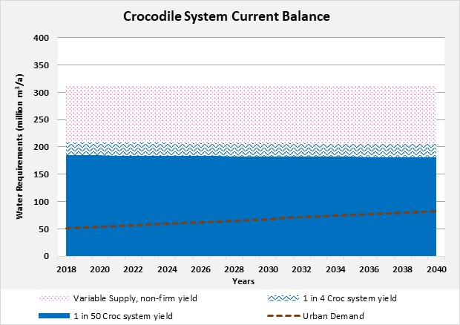
CROCODILE SYSTEM
allocation

Slide 20
CROCODILE SYSTEM

Slide 21
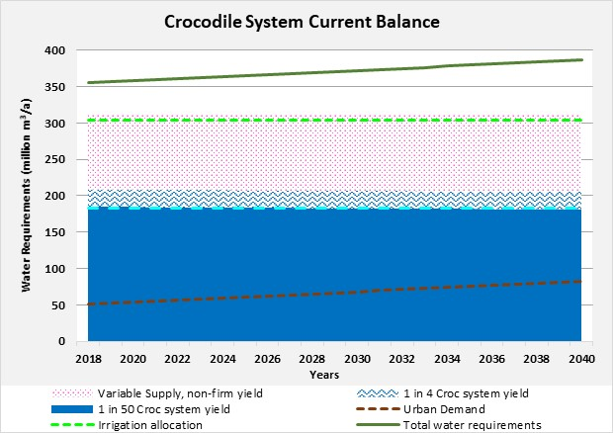
CROCODILE SYSTEM

Slide 22
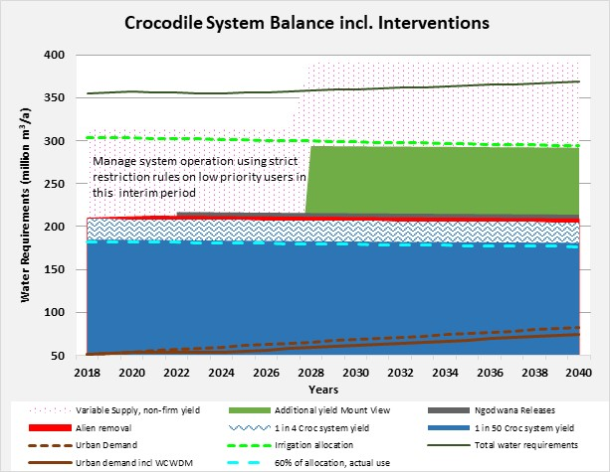
CROCODILE SYSTEM

Slide 23
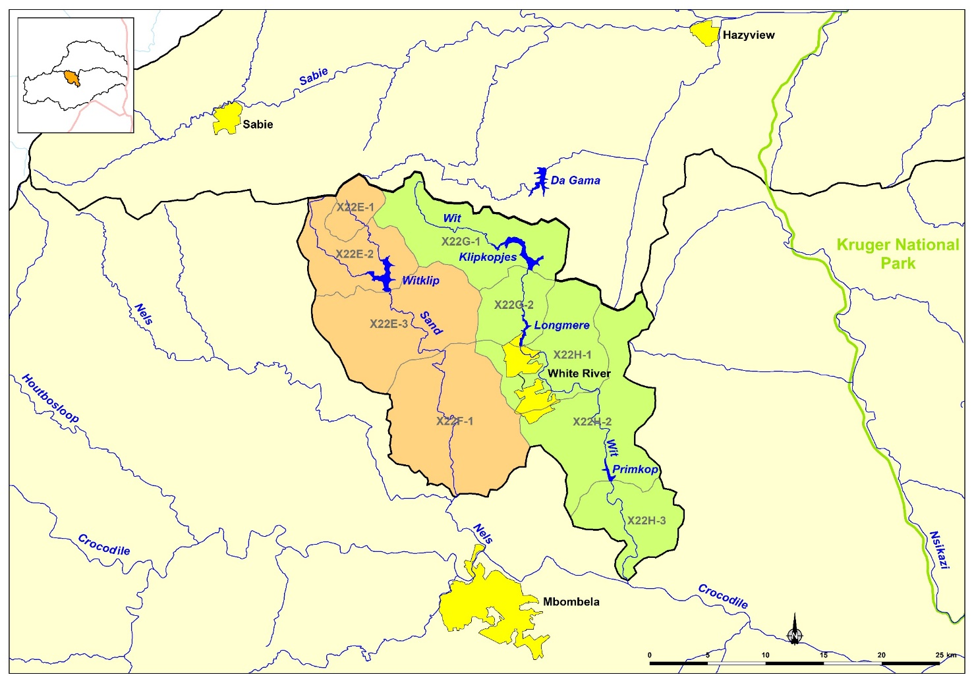
WHITE RIVEr SUB- SYSTEM

Slide 24
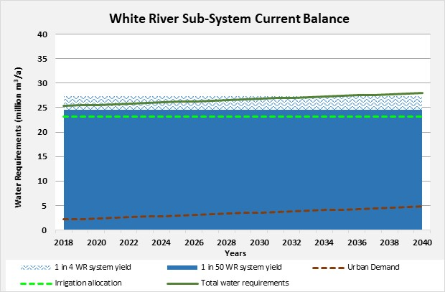
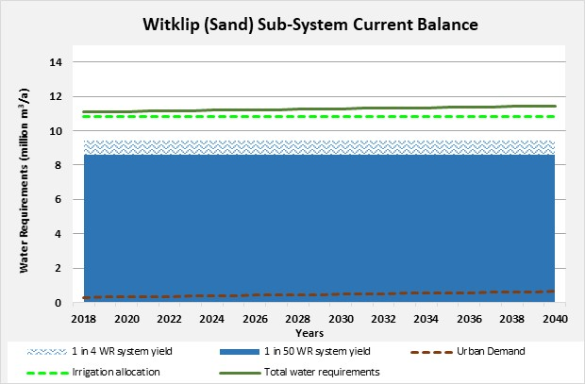
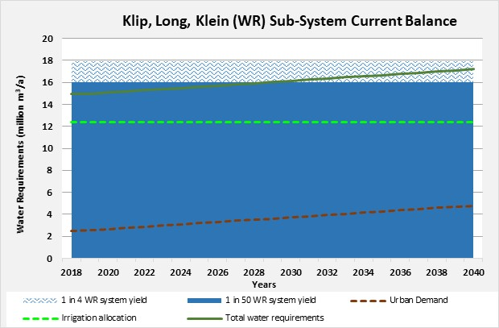
WHITE RIVEr SUB- SYSTEM

Slide 25
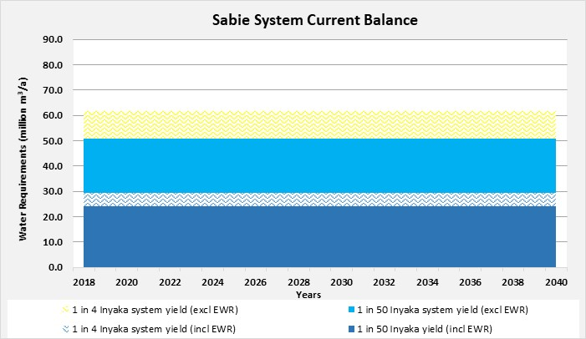
SABIE-SAND SYSTEM: Yields

Slide 26
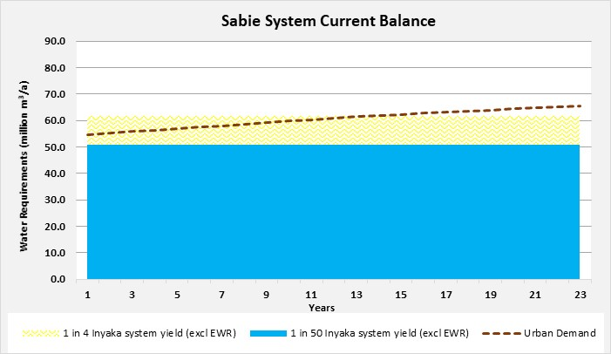
SABIE-SAND SYSTEM

Slide 27
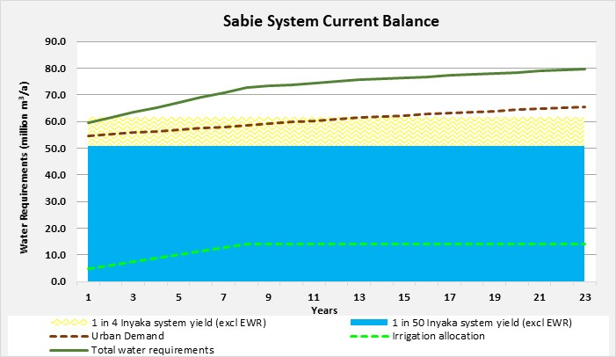
SABIE-SAND SYSTEM

Slide 28
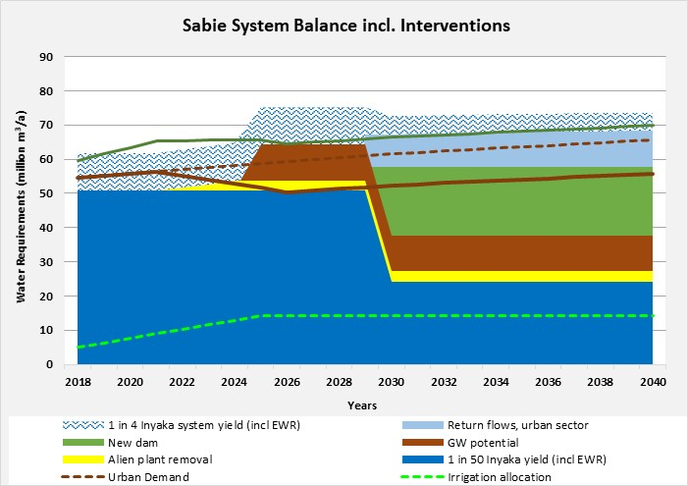
SABIE-SAND SYSTEM

Slide 29
CONTINUATION OF WATER REQUIREMENTS AND AVAILABILITY RECONCILIATION STRATEGY FOR THE MBOMBELA MUNICIPAL AREA (Crocodile Sabie River System Reconciliation Strategy) Strategy Steering Committee Meeting StraSC 5 Item 8: Proposed Action Plan

Slide 30
PROPOSED ACTION PLAN
INSTITUTIONAL RESPONSIBILITY
DWS
CMA
Municipalities
Other
TIME FRAMES

Slide 31
Intervention | Primary Responsibility | Comments | Target Date (priority) | Savings Target
WCWDM | Local Municipalities: City of Mbombela LM, Bushbuckridge LM, Emakhazeni LM, Thaba Chweu LM Nkomazi LM | Bushbuckridge LM to finalise process to appoint service provider to assist with WCWDM activities City of Mbombela to continue with and increase existing WCWDM programme | High priority, implementation to continue/start immediately | Mbombela: 6.1 million m³/a by 2025 Bushbuckridge: 7 million m³/a by 2025
Reduce canal losses | City of Mbombela LM | Focus on canal supplying Nelspruit WTW and canals in the White River area | Medium priority level, as and when funds available | To be determined: 0.19 million m³/a on allocation from Longmere

Slide 32
Intervention | Primary Responsibility | Comments | Target Date (priority) | Savings Target
Remove alien vegetation | Department of Environmental Affairs, WWF & Sanparks | Focus on areas upstream of Inyaka and Kwena Dams | High priority, implementation to continue/start immediately | Croc: 4 million m³/a Sabie: 3 million m³/a
Water use entitlement exchange from irrigation to urban | Department of Water and Sanitation: Directorate Water Use Authorisation City of Mbombela, IUCMA | Follow procedure for reallocation of water licenses as laid out by DWS. It is important that the reasons behind the delay in process are understood in order to streamline future applications | High priority, implementation to continue/start immediately 2021 for existing applications Ongoing for additional applications | 10 million m³/a till 2040

Slide 33
Intervention | Primary Responsibility | Comments | Target Date (priority) | Savings Target
Eliminating unlawful uses | IUCMA | The process of V and V has taken significant time and requires completion before any action can take place on this intervention | High priority, implementation to continue/start immediately Target date: 2022 | To be confirmed
Compulsory licensing | IUCMA | Engage Stakeholders in Compulsory license process The process should be transparent and clearly defined objectives communicated | Target date: 2025 if required | N/A

Slide 34
Intervention | Primary Responsibility | Comments | Target Date (priority) | Savings Target
Water Reuse | Bushbuckridge LM | This intervention is focused on the Bushbuckridge LM supply area and is designed to add additional resources after the implementation of a new dam | Medium priority level, when new dam constructed | 25% urban use (10 million m³/annum)
Interim Restriction Rule to Benefit Priority (Primary) Users | DWS: Directorate Water Resources Planning Systems, IUCMA | DWS has recently awarded a study to a professional service provider that can assist with annual operating analyses for three years. This study will produce dynamic operating rules | Immediate and ongoing | N/A

Slide 35
Intervention | Primary Responsibility | Comments | Target Date (priority) | Savings Target
Efficient system operation | IUCMA and users | The existing system should not be allowed to fail, and should be expanded to additional key flow monitoring points throughout the catchments. It is specifically important to improve the flow monitoring in the White River in order to undertake a more accurate hydrological assessment. | Immediate and ongoing | N/A
Groundwater Development | IUCMA, Local Municipalities | This intervention is focused on the Bushbuckridge LM supply area, however, could also benefit the City of Mbombela if the detailed study indicates so | Ongoing | 10.5 million m³/annum in Sabie

Slide 36
Intervention | Primary Responsibility | Comments | Target Date (priority) | Savings Target
New Dam Construction & Existing Dam Raising | DWS: Options Analyses (large dams) CoM (Primkop) | Tendering to be undertaken by implementing agent, Construction to be outsourced. | Urgent and requires fast tracking. Construction to be complete by 2030. | 78 million m³/annum for Croc 20 million m³/annum for Sabie
Water releases from Ngodwana Dam | DWS: NWRP CoMLM, Sappi | This option requires further investigation in terms of the water availability and viability of the release. Closer monitoring of Ngodwana dam should be undertaken in order to quantify the excess water available | Medium priority level | 5 million m³/annum

Slide 37
FUTURE STRATEGY UPDATES
Incorporate new hydrology
Update modelled landuse
Water requirement projections and monitoring
Actual use: irrigation sector
Waps & cms
Groundwater
Bbr population
Strasc coordination & implementation tracking

Slide 38
CONTINUATION OF WATER REQUIREMENTS AND AVAILABILITY RECONCILIATION STRATEGY FOR THE MBOMBELA MUNICIPAL AREA (Crocodile Sabie River System Reconciliation Strategy) Strategy Steering Committee Meeting StraSC 5 Item 9: Discussions

